Slide 1
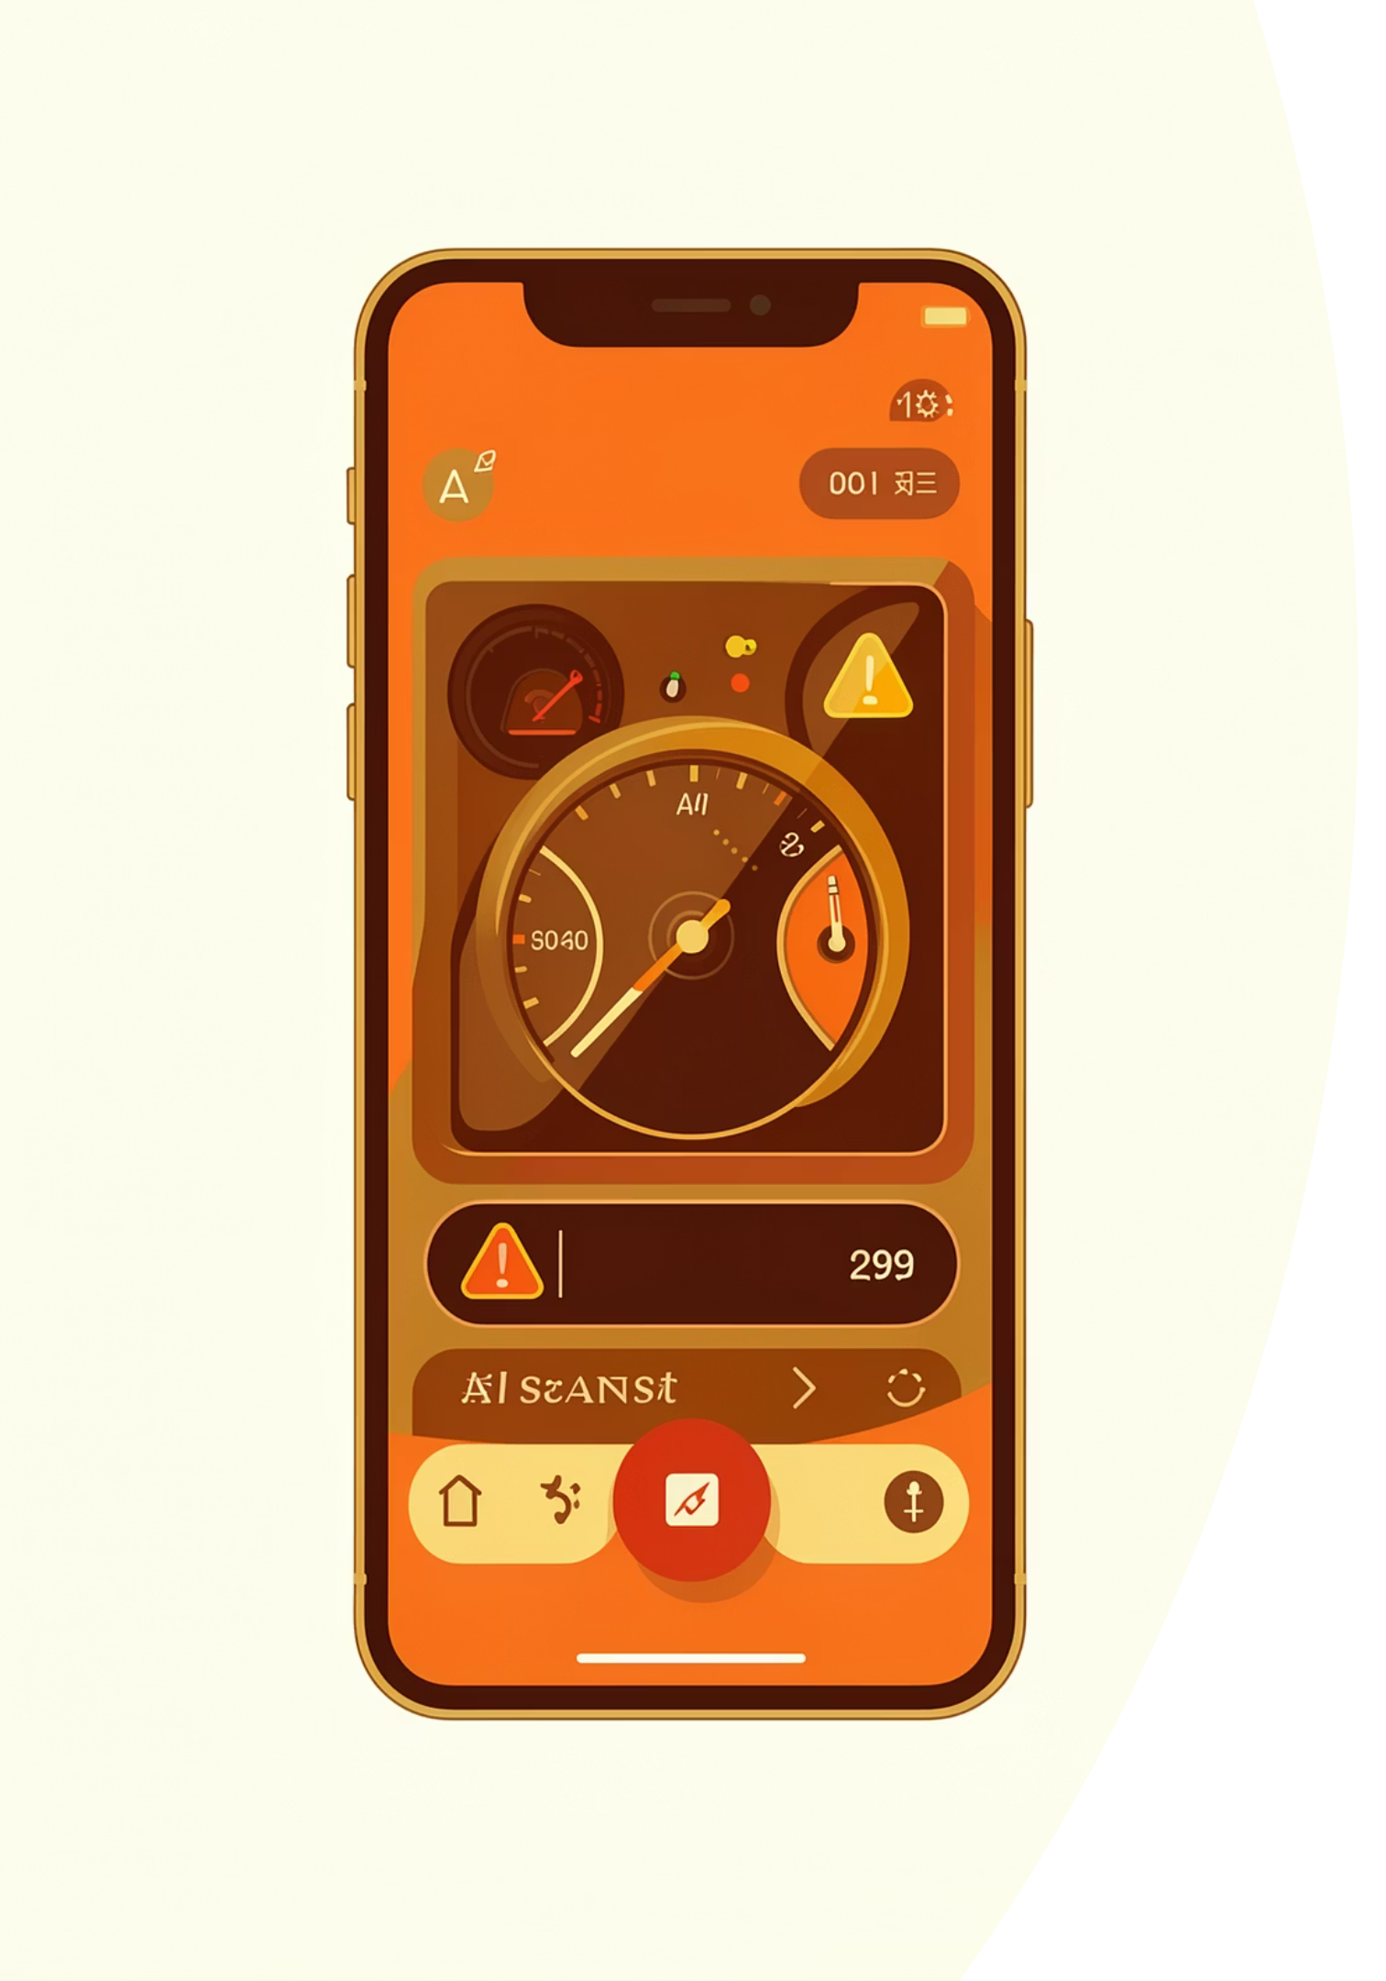
CarDiag: Mobile Car Fault Diagnosis
CEF 440 — Internet & Mobile Programming · Dr. Nkemeni Valery · Group 8
REQUIREMENT ANALYSIS REPORT

Slide 2

The Problem
83.3%
66.7%
Have seen an unknown dashboard warning light
Ignored a warning light due to not understanding it
85.2%
Have heard an unusual engine sound
Existing solutions require expensive tools, OBD-II dongles, or specialist knowledge.

Slide 3

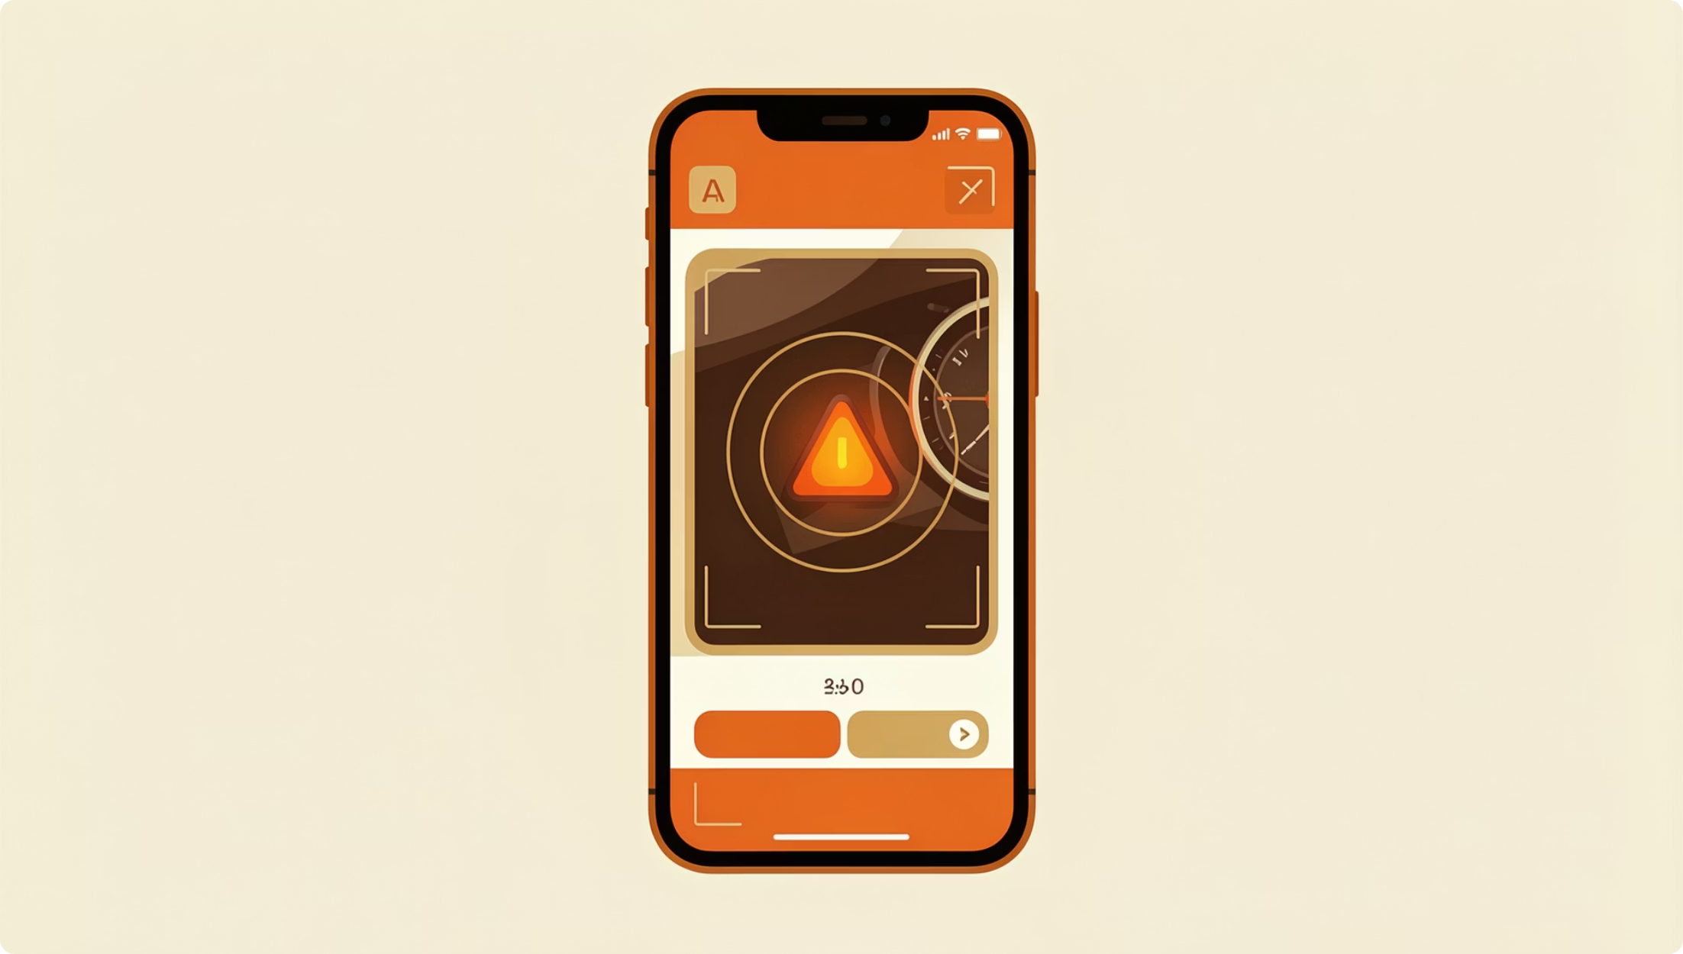
The Solution: CarDiag
Camera Scan
Recognize warning lights via phone camera
Sound Diagnosis
Analyze engine audio for fault patterns
Offline-First
All core features work without internet
Urgency Guidance
Color-coded urgency + mechanic referral

Slide 4
Requirements at a Glance
22
11
Functional Reqs.
Non-Functional
FR01–FR22
NFR01–NFR11
8
54
Gaps Found
Survey Respondents
GAP-01 to GAP-08
Across two phases
Plus 6 ambiguities (AMB-01–06) and 5 inconsistencies (INC-01–05) identified and resolved.

Slide 5
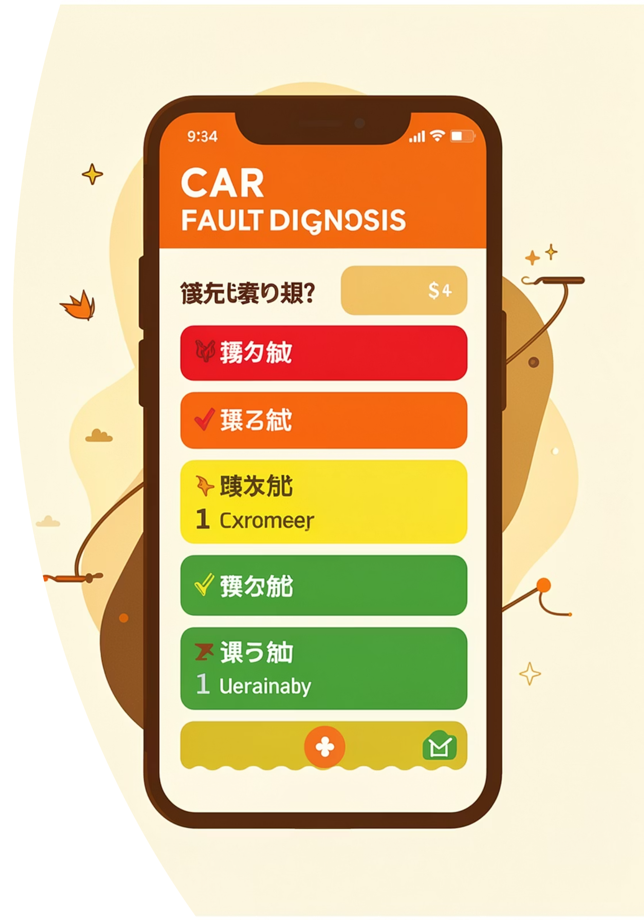
Key Functional Requirements
FR01 — Camera Scan
1
On-device CV model recognizes dashboard symbols
FR06 — Audio Classification
2
ML classifier detects knocking, squealing, grinding
FR08 — Urgency Levels
3
Low / Medium / High / Critical — color-coded
FR11 — Offline Mode
4
Core features work from first launch, no internet

Slide 6
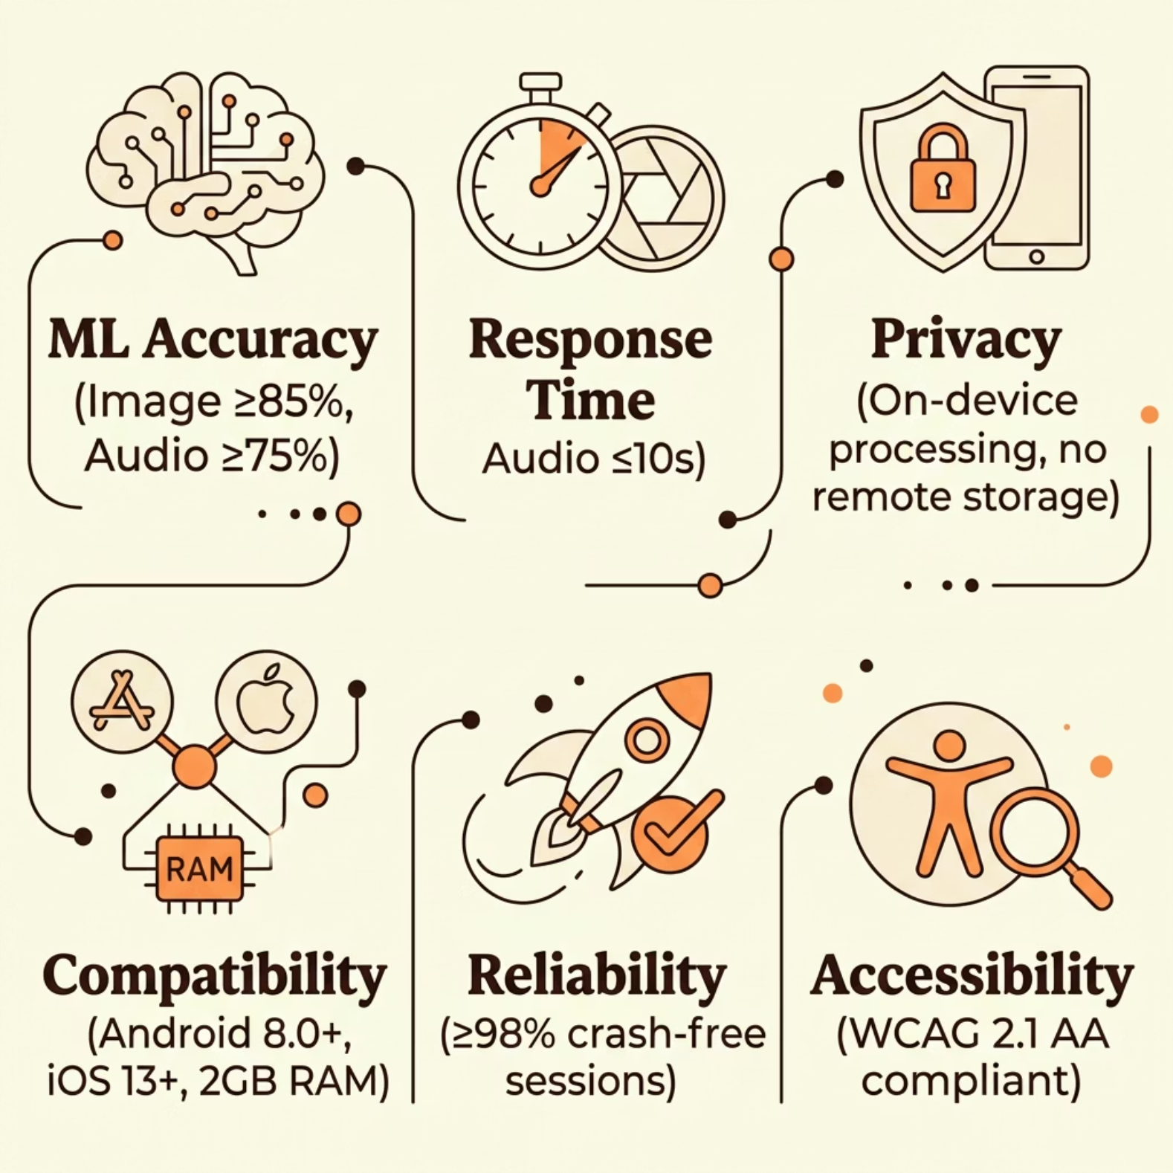

Non-Functional Requirements
Quality Targets
ML Accuracy: Image ≥85%, Audio ≥75%
Response: Camera ≤3s, Audio ≤10s
Privacy: On-device inference only
Platform: Android 8.0+ / iOS 13+
Reliability: ≥98% crash-free sessions

Slide 7
Gaps & Ambiguities Resolved
GAP-01: ML Accuracy
GAP-03: Privacy Policy
Set thresholds: image ≥85%, audio ≥75% (NFR03)
On-device inference; raw data never transmitted (NFR05)
AMB-03: "Diagnose" vs. "Possible Causes"
INC-01: Urgency Levels
Adopted 4-level system (Low/Medium/High/Critical)
Standardized to "preliminary assessment" — never "diagnosis"

Slide 8

Technical Feasibility
✅ High
Camera recognition, offline inference, video links
⚠️ Medium
Audio classification, multi-light detection, engine diversity
🔲 Low (Deferred)
Mechanic directory, OBD-II integration
TensorFlow Lite enables on-device ML. Target app size: <150 MB.

Slide 9

Stakeholder Validation
Car Owners
Validated: scan, sound diagnosis, urgency levels, offline mode
Mechanics
"An assistant, not a replacement" — confidence scores required
Auto Electricians
Multi-light detection & electrical fault categorization validated
Drivers
Offline-first, fast results, clear "stop driving" urgency critical

Slide 10

MoSCoW Prioritization & Roadmap
Version Roadmap
v1.0 — MVP
Camera scan, urgency, offline, safety disclaimers
v2.0
Audio diagnosis, vehicle profiles, French language
v3.0+
OBD-II integration, mechanic directory

